Slide 1
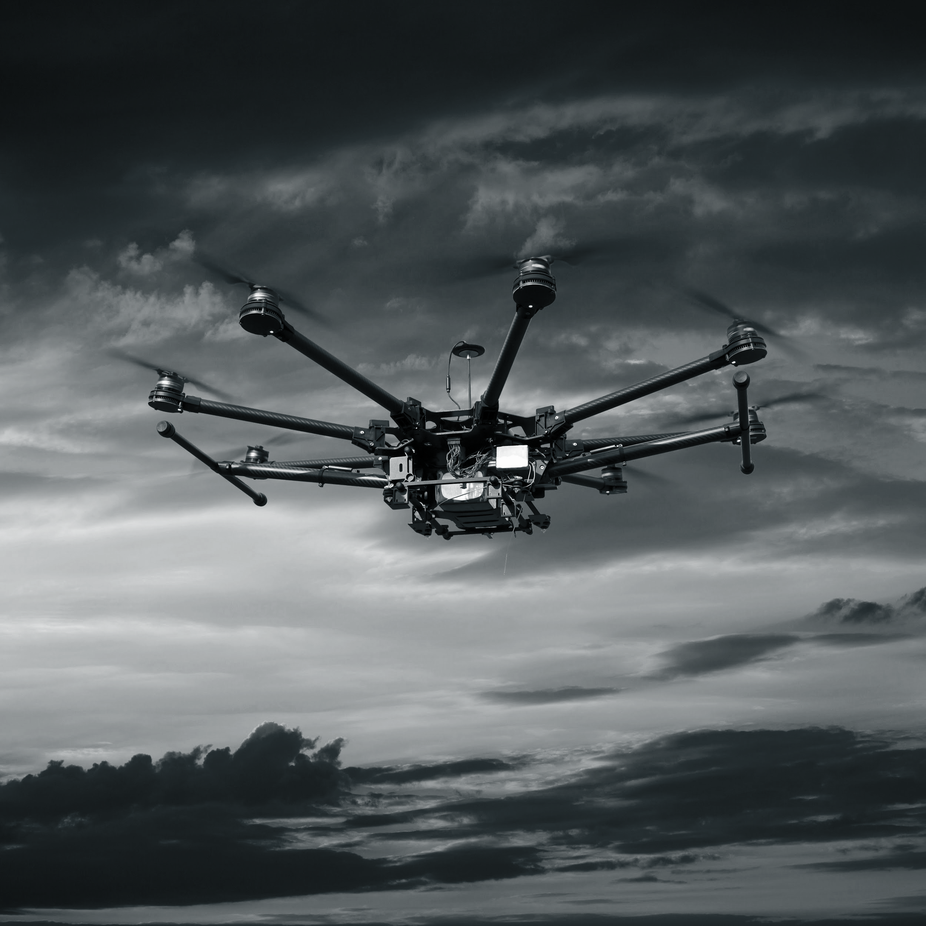
Autonomous Parcel Delivery - ELCA Challenge
Polyhack 2018
ELCA$H

Slide 2
Scope - Index
Solution Overview
Unique Selling Proposition
Path Planning Strategies
Challenges

Slide 3

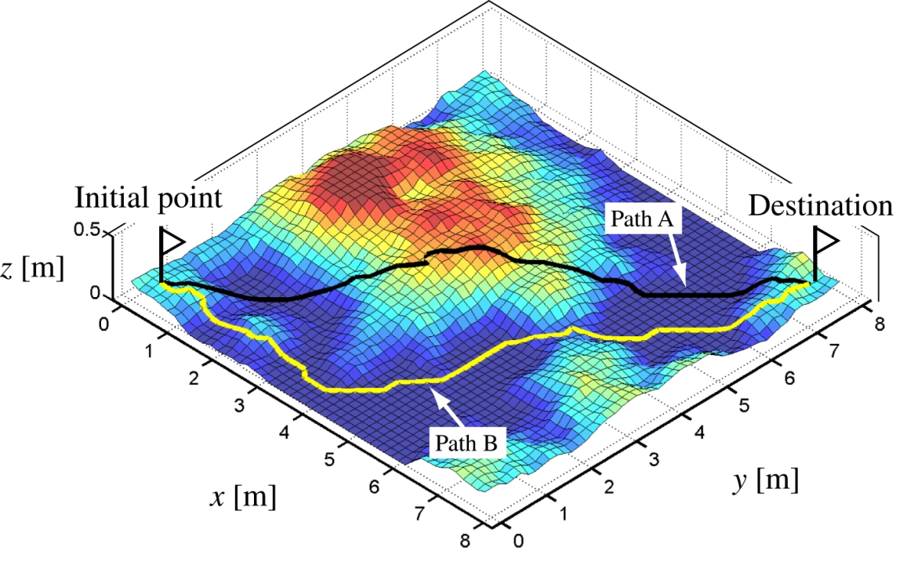
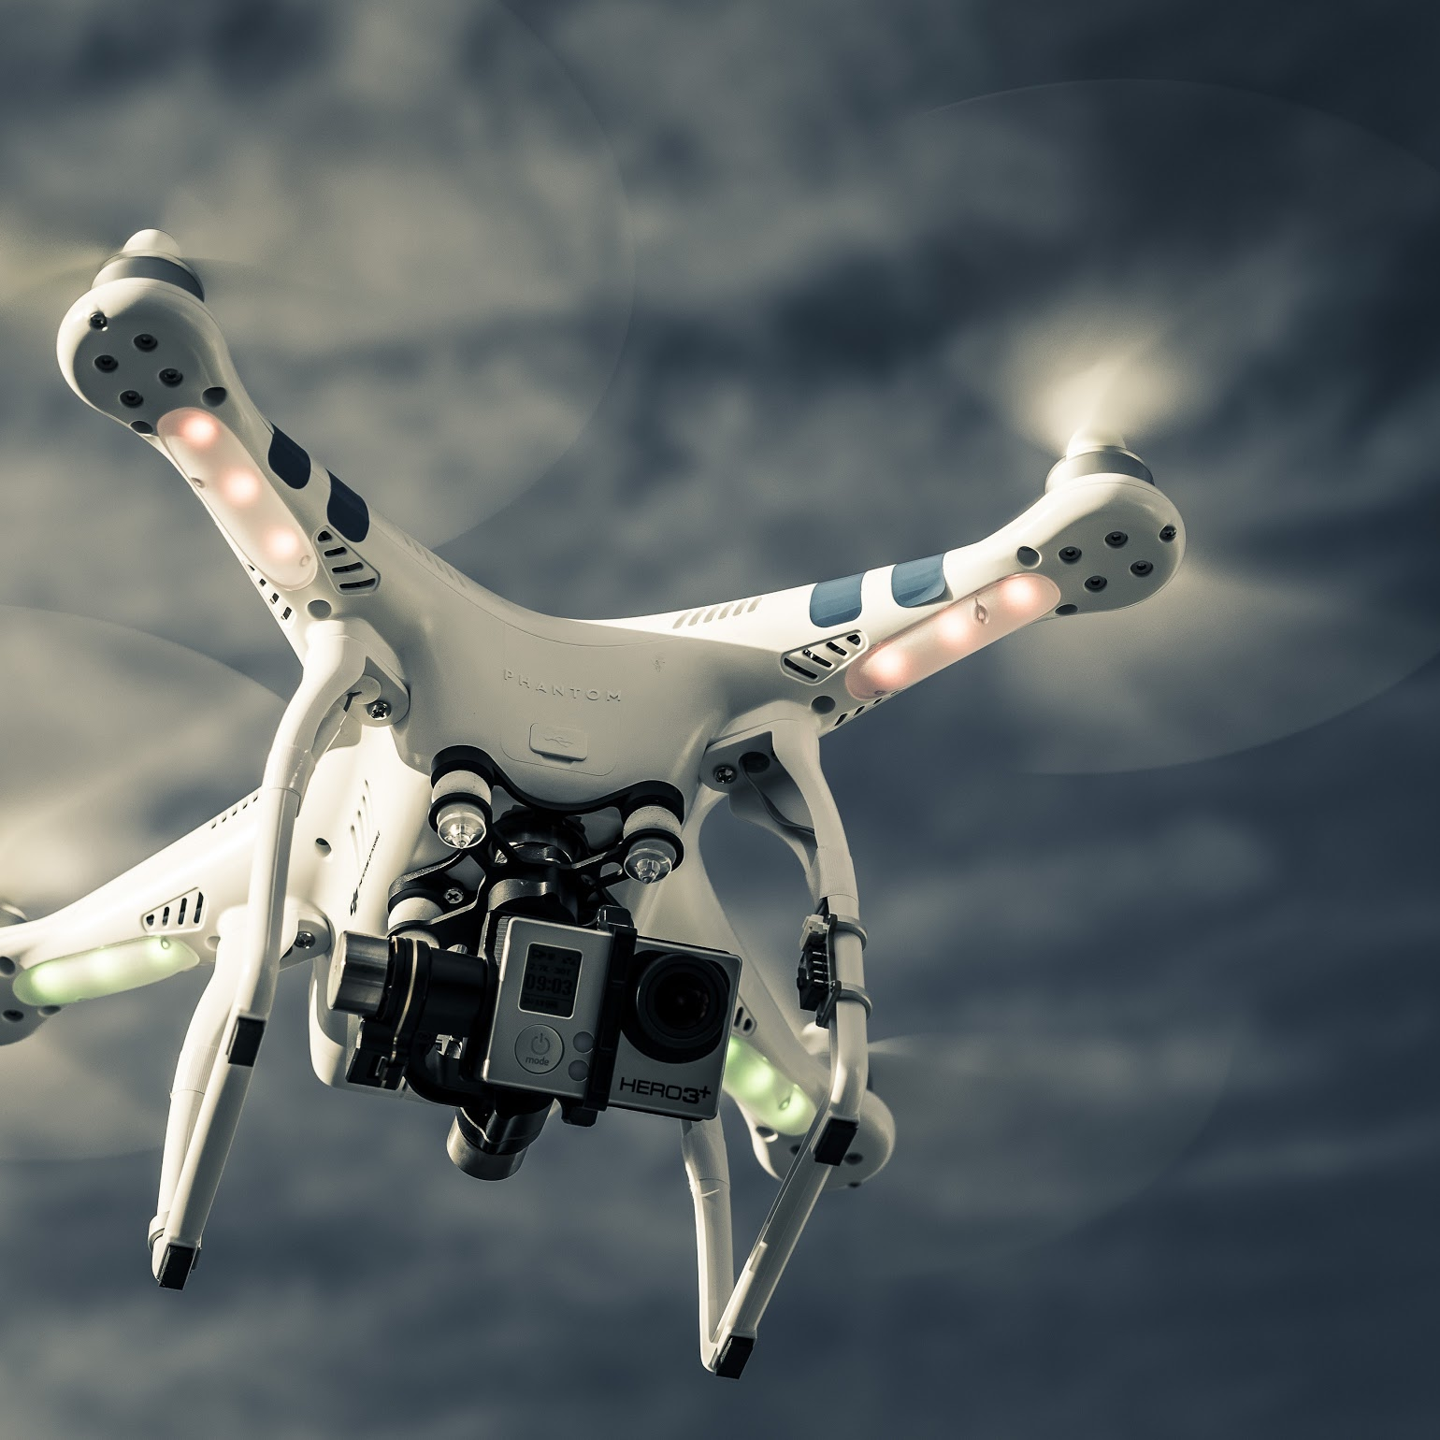
Adaptable drones that deliver
Modular design
Reliable planning
Efficient delivery
The drones operate under the Robot Operating System for collaborative robotics software development
Path planning calculates the optimal path between pick-up and delivery locations
With the addition of multiple drones, parcels are delivered fast and continuously throughout the day

Slide 4
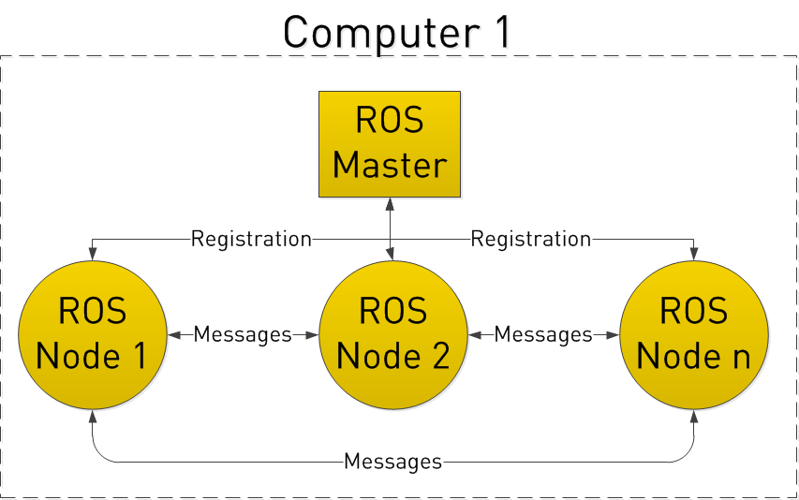
Drones that adapt to emerging technologies
ROS allows collaborative robotics software development
Nodes in ROS do not have to be on the same system (multiple computers) or even of the same architecture!
4

Slide 5
Path Planning Part 1 -
Dijkstra's algorithm
Graphical representation of the arena with nodes (drop-off locations and intermediate nodes)
Finds shortest path by calculating the cost between nodes (distances)
Simple approach to implement early in the developing process
5

Slide 6
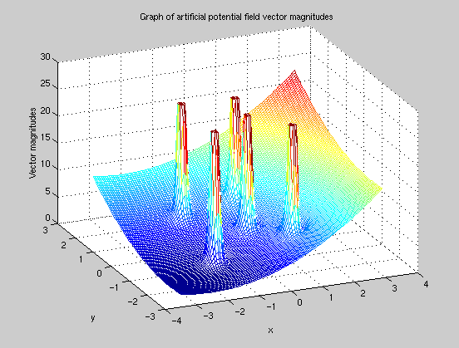
Path Planning Part 2- Potential field
The algorithm creates an artificial potential field that attracts the drones to the desired position.
Obstacles (buildings or other drones) are set as hills and the desired position is set as a valley
Parameter tuning represented a challenge with the noise of the arena
6

Slide 7
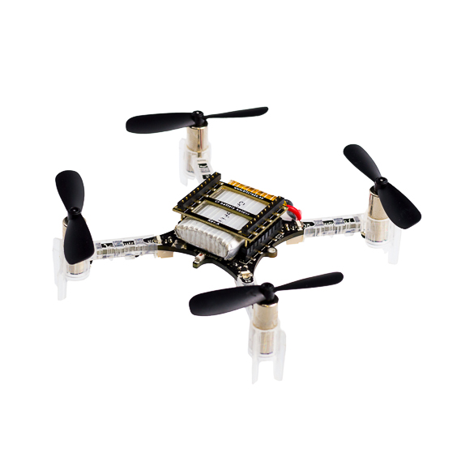
Localization, localization, localization
“Strength and growth come only through continuous effort and struggle ” - N. Hill
Given the inaccuracy in the localization of the drones, a smooth path to the desired position was a challenge
Disturbance in landing lead to early building (or drone) crashing
7

Slide 8

Questions?

